Slide 1

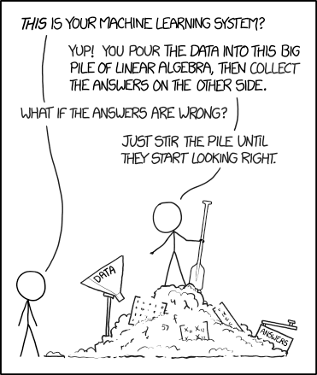
Subreddit Classification
DSIR1011 – Project 3
by Joomart Achekeev
Ripped of Internet, not mine

Slide 2
Executive summary
Initial idea was to web scrape 120 subreddits, 1500 posts deep each.
Due to lots of deleted posts and large database, ended up scrapping over 78 subreddits, 2000 posts deep.
Out of those only 9 subreddits were left with more than 1000 posts after data cleaning (5 of these subreddits are about computer games)
that was ~12_000 rows of data, title in one column, text in the other.
Modelling took a whole day, with some of the cells running for over and hour
The best one was base Bagging model with no tweaks (Grid Searches take forever to run) and gave me 62.13% accuracy on subreddit post text, and 55.52% accuracy on subreddit post title

Slide 3
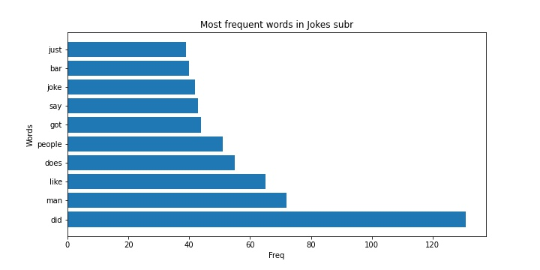
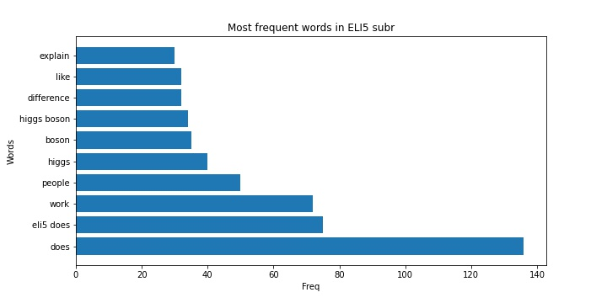
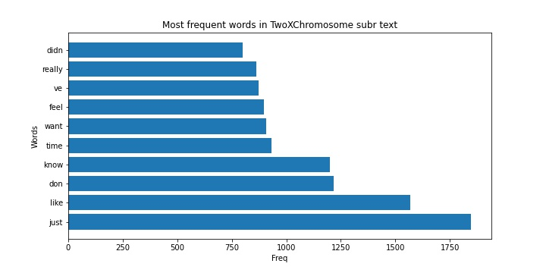
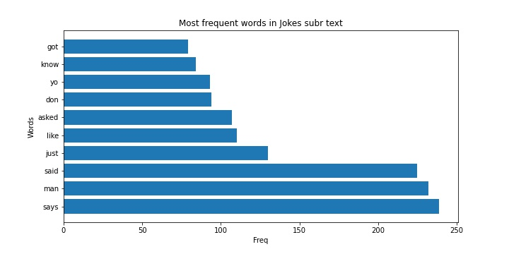
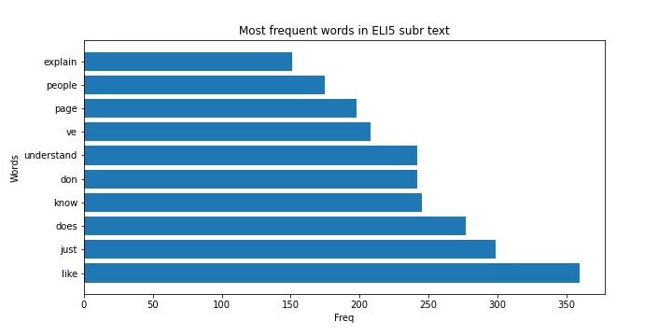
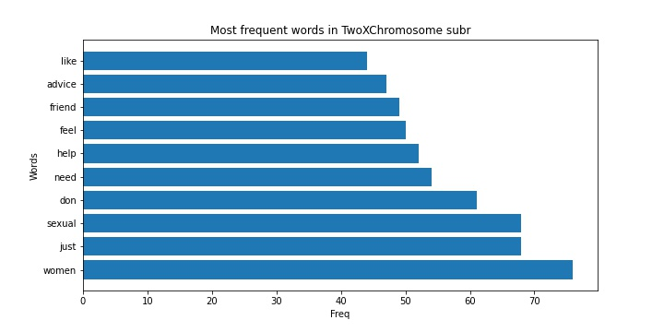
Some EDA

Slide 4
Models
DecisionTreeClassifier
53.98% on the title data
57.15% on the text data
K Nearest Neighbors
35.55% accuracy for title
31.37% accuracy for text
KNN model grid search
returned 40.6% accuracy for title on {'n_neighbors': 3, 'weights': 'distance’} hyperparameters
33.14% accuracy for text on {'n_neighbors': 5, 'weights': 'distance’} hyperparameters.
Bagging model
55.52% for title data
62.13% for text data. <== BEST SCORE
Stacking model - additionally to using all three level one models to fit the stacking model, I have used title and text data combined.
46.77% for combined data

Slide 5
Conclusion
Initial idea to web scrape 120 subreddits, 1500 posts deep each was a bad idea.
The complex models, especially ensemble models from sklearn need lots of computing power so either feed them small dataframes, or get more computing power.
There are numerous ways to improve on the models used in the project 3, a more thorough hyperparameter grid search in each models, use tfi-df vectorizer instead of count vectorizer, tweak stop_words, tweak n_grams and others.
Estimate your resources carefully.

